Slide 1
Module 1:
Introduction To System Design
Sanket Singh SWE 2 @ Google

Slide 2
What will you learn
Case study of Delicious
Designing basic Delicious

Slide 3
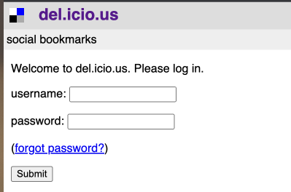
Delicious was founded in 2003 and got acquired by yahoo in 2005
It is a social bookmarking application
Notes:
Let’s discuss an interesting case study

Slide 4
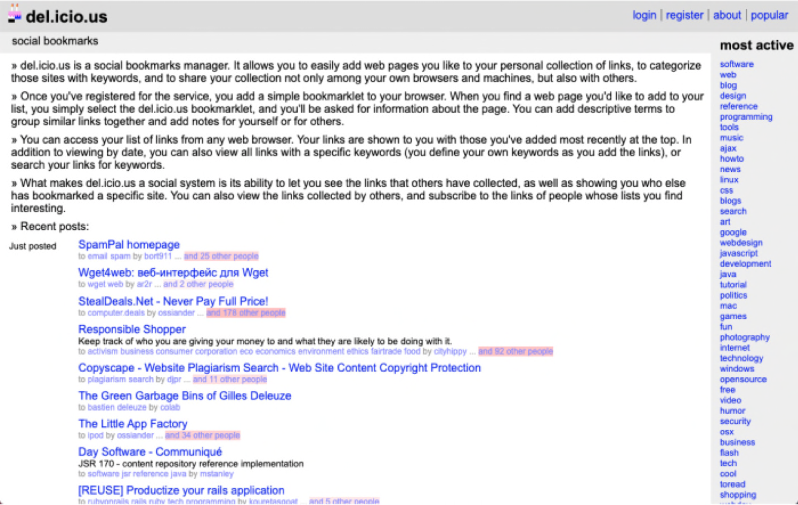
Notes:
Interesting fact about the app is that for a long period of time the app was running on a personal computer.

Slide 5
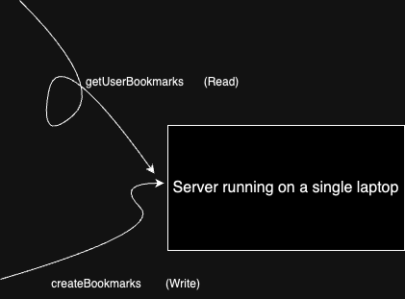
2 Major operations
Notes:
Lets think if we have to build something like delicious how can we do it

Slide 6
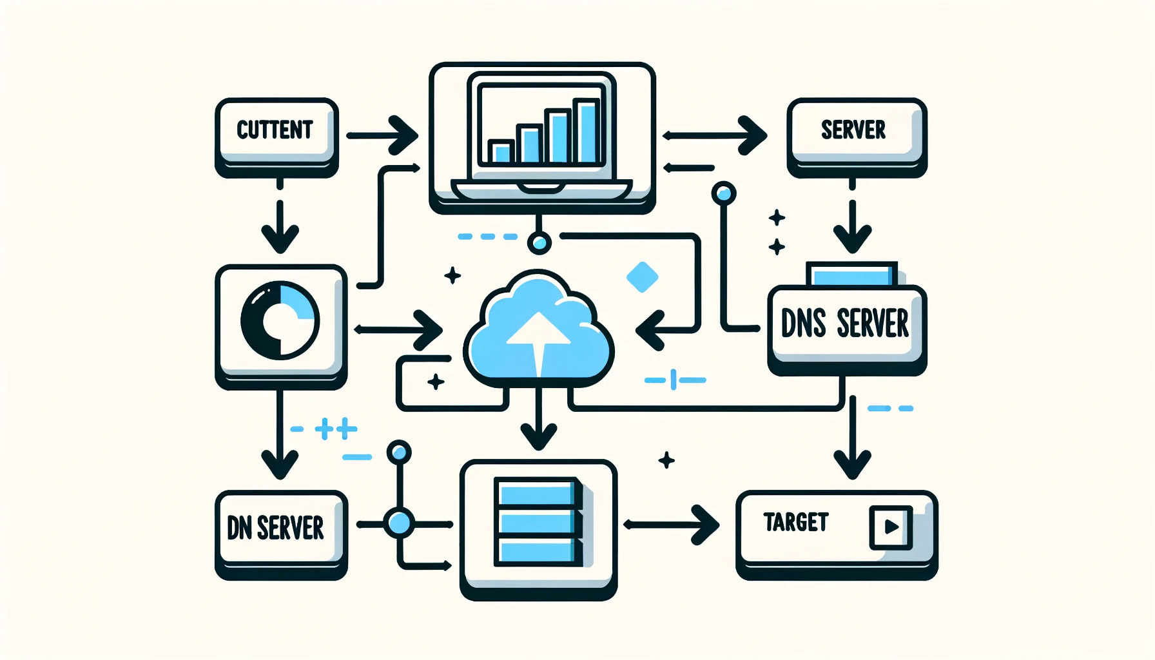
App architecture
Notes:
There are three main components of the delicious app
Client
Server
DNS

Slide 7
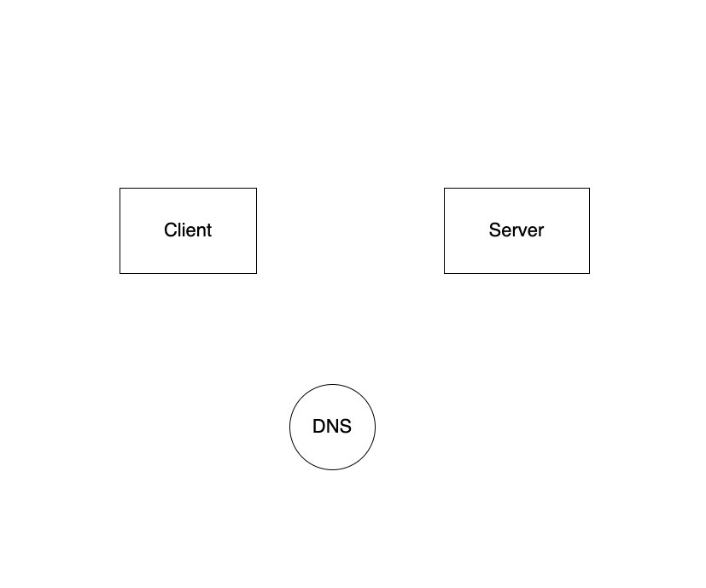
App architecture
Notes:
There are three main components of the delicious app
Client
Server
DNS

Slide 8
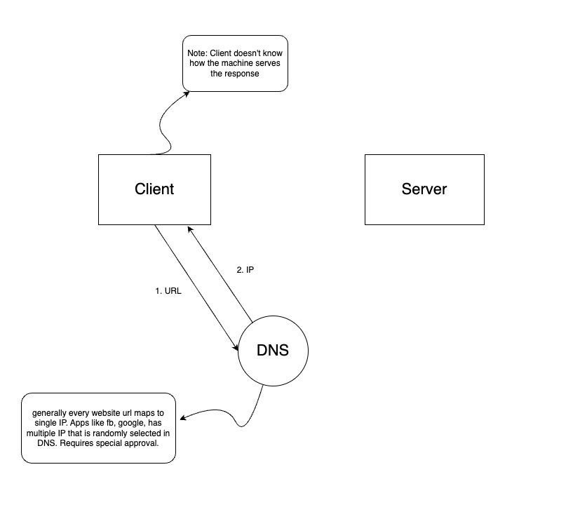

Slide 9
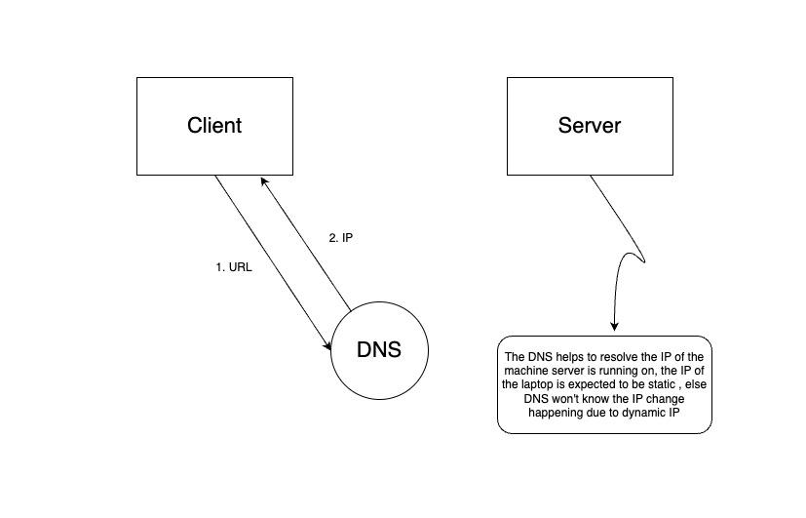

Slide 10
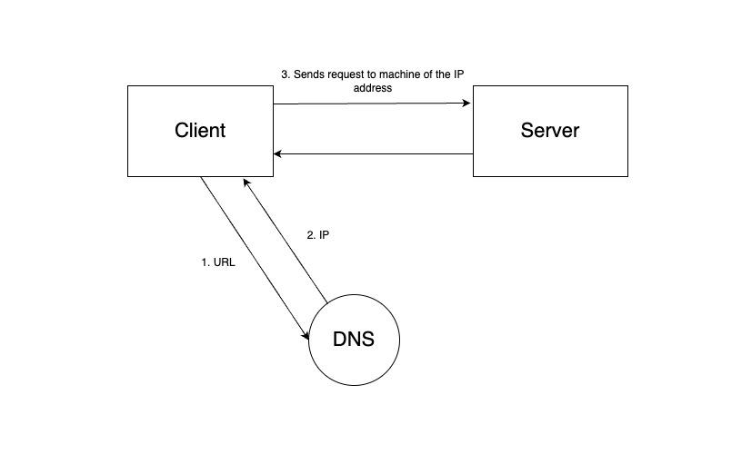

Slide 11
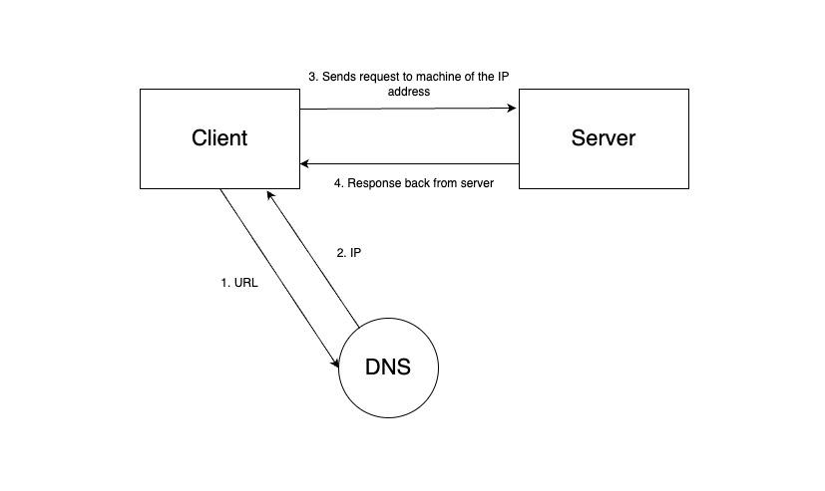

Slide 12
How do we know which DNS to hit ?
Generally ISP provides us this info
Google also provides free DNS servers
For delicious , the DNS returned the IP of the laptop running the server

Slide 13
Recap
Delicious was launched as a social bookmarking app
For a long time the servers used to run on a local personal machine
App architecture required basic client server interaction
DNS needs to hit the static ip for the machine

